Slide 1
JAVA Lecture 25
JDBC

Slide 2


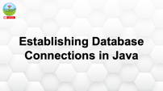


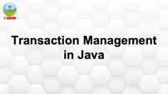



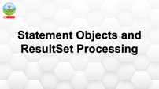


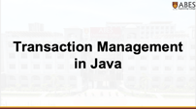
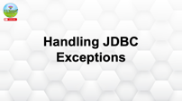

Slide 3
JDBC Overview and Driver Types

Slide 4
What is JDBC?
JDBC is an API in Java to interact with relational databases.
Allows:
✅ Connecting to a database
✅ Executing SQL queries
✅ Processing results
✅ Part of the java.sql package.

Slide 5
Basic JDBC Workflow
Load JDBC Driver
Establish a Connection
Create Statement
Execute Query
Process Result
Close Connection
✅ Standard pattern followed for database interaction.

Slide 6
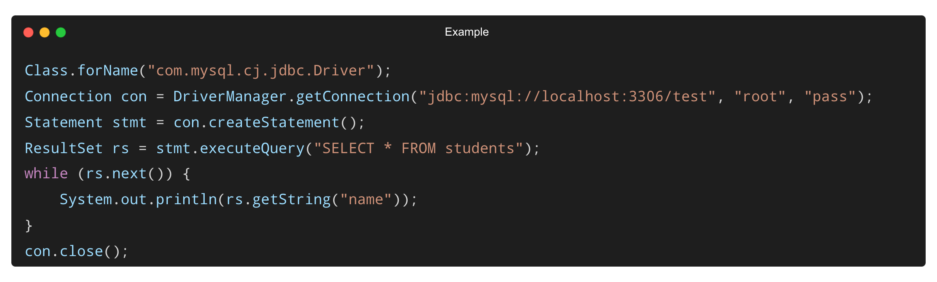
Example – Basic JDBC Steps
✅ A simple MySQL example using JDBC.

Slide 7
Types of JDBC Drivers
Type | Description
Type 1 | JDBC-ODBC Bridge (Legacy)
Type 2 | Native API Driver
Type 3 | Network Protocol Driver
Type 4 | Thin Driver (Pure Java)
✅ Type 4 is most commonly used today.

Slide 8
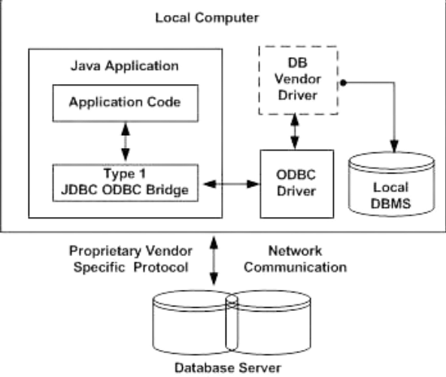
Type 1 – JDBC-ODBC Bridge
Uses ODBC driver to connect.
Platform-dependent, requires native setup.
✅ Deprecated since Java 8.

Slide 9
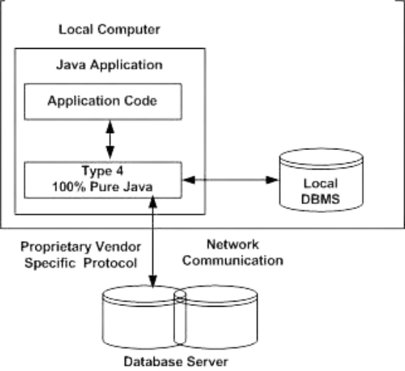
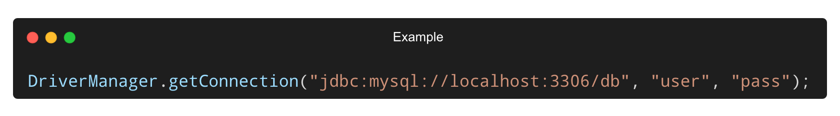
Type 4 – Thin Driver (Pure Java)
Communicates directly with DB server using native protocol.
No native libraries required.
✅ Best choice for web applications.

Slide 10
Best Practices with JDBC Drivers
✅ Always close Connection, Statement, and ResultSet.
✅ Prefer Type 4 drivers for modern applications.
✅ Use connection pooling for better performance.
✅ Handle exceptions with meaningful error messages.

Slide 11
Establishing Database Connections in Java

Slide 12
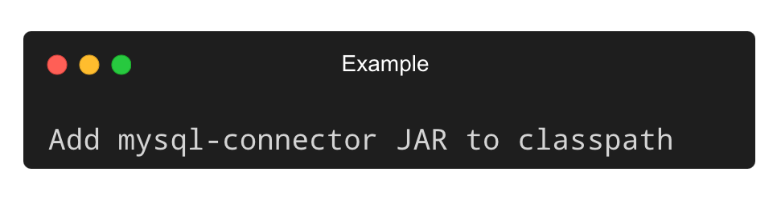
Required Libraries for JDBC
✅ JDBC API is built-in with JDK.
✅ You also need a driver JAR file (like mysql-connector-java-x.x.xx.jar) for external databases.
Example (MySQL):
✅ Required to use Type 4 drivers.

Slide 13
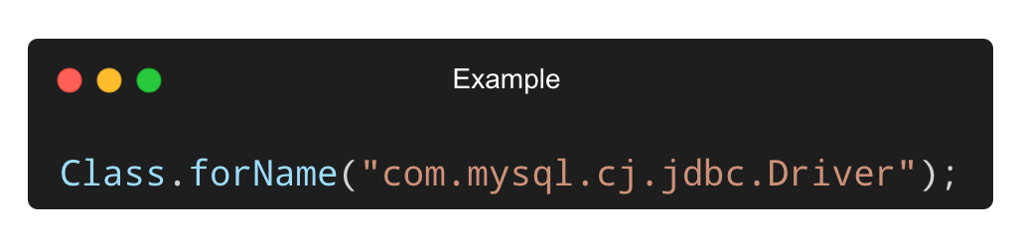
Loading the JDBC Driver
✅ Dynamically loads the driver class.
✅ This step is optional in JDBC 4.0+, but still commonly used for compatibility.

Slide 14
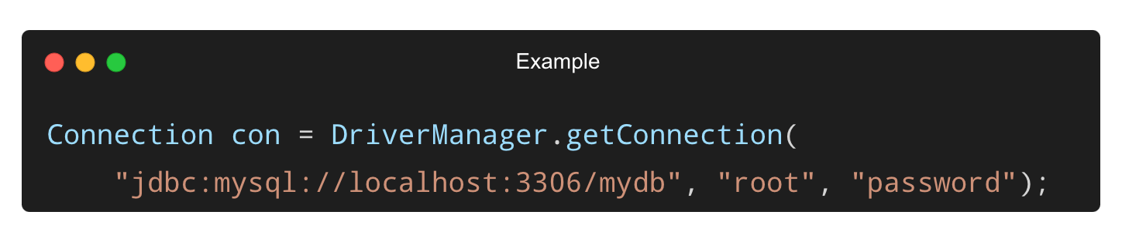
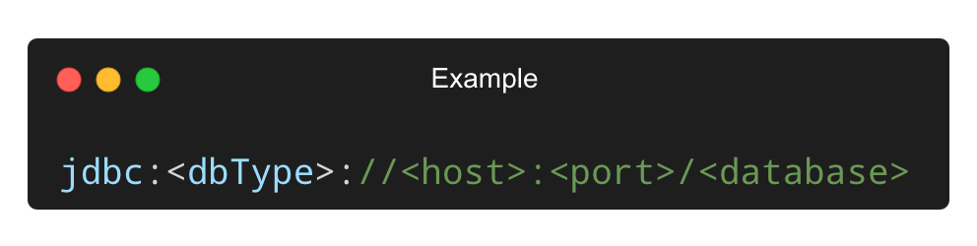
Establishing a Connection
✅ URL Format:
✅ Replace mydb, root, and password with your own values.

Slide 15
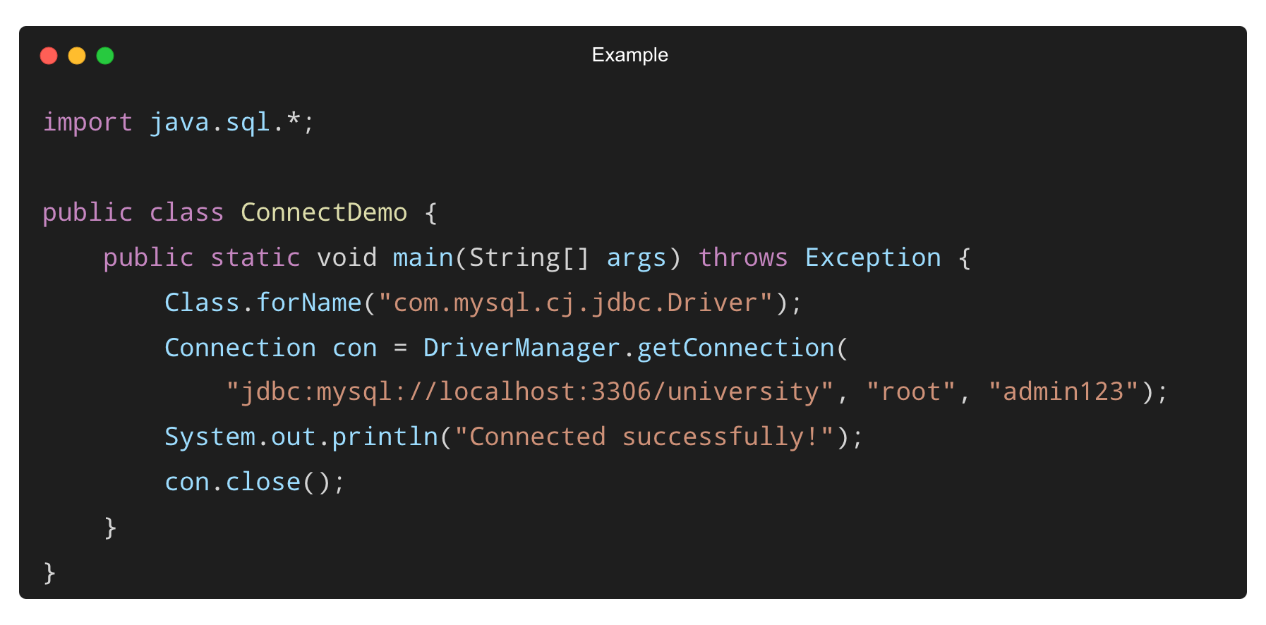
Complete Example – Connection Setup
✅ Successful connection prints confirmation.
✅ Always close the connection after use.

Slide 16
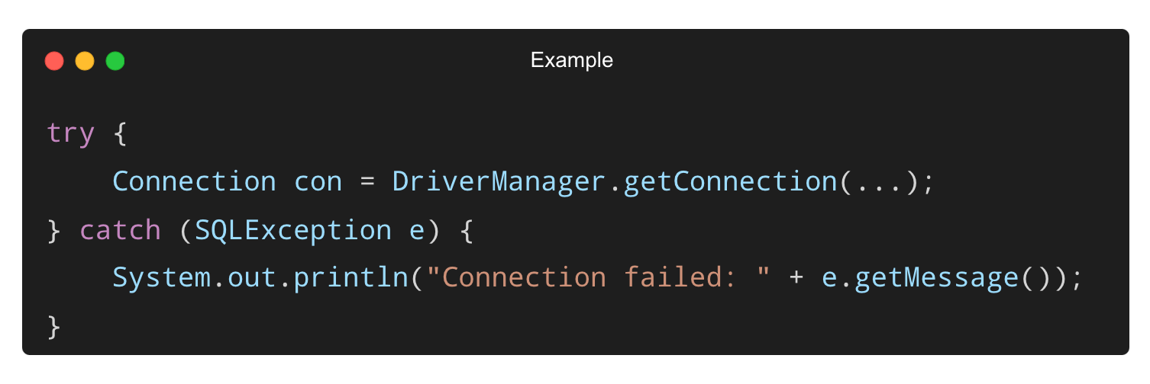
Handling Connection Exceptions
✅ Catch SQLException to handle invalid credentials, wrong URL, or network errors.

Slide 17
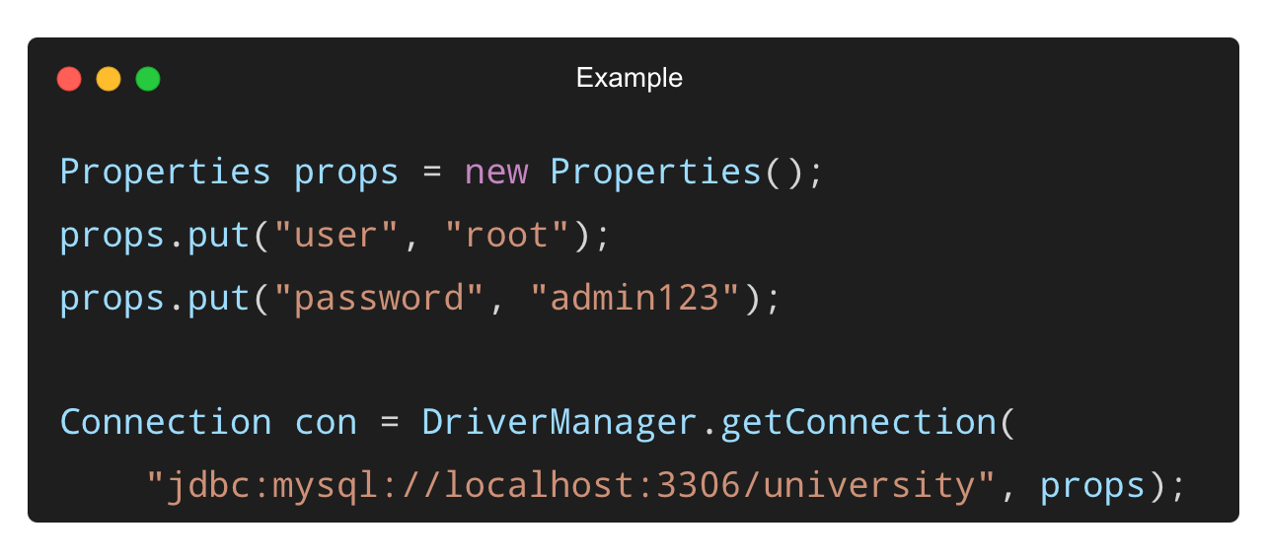
Connection Properties (Optional)
✅ Use Properties for cleaner configuration.

Slide 18
Best Practices for Database Connections
✅ Always close Connection inside finally or use try-with-resources.
✅ Never hardcode credentials – use config files or environment variables.
✅ Use connection pools (e.g., HikariCP) in production.
✅ Validate connection with con.isValid(5) before use.

Slide 19
Statement Objects and ResultSet Processing

Slide 20
What is a Statement in JDBC?
A Statement is used to send SQL queries to the database.
Three types:
✅ Statement – for simple SQL
✅ PreparedStatement – for parameterized queries
✅ CallableStatement – for stored procedures
✅ All extend the java.sql.Statement interface.

Slide 21
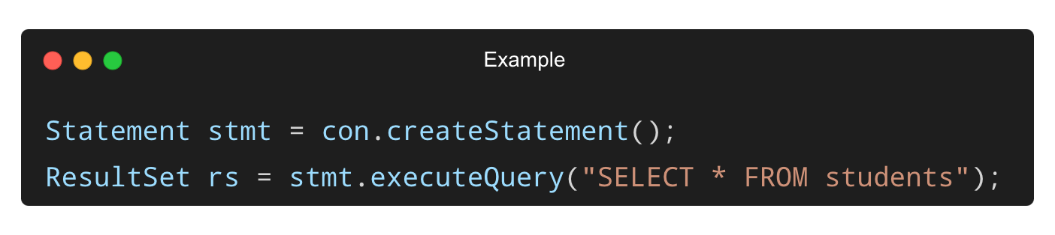
Creating and Using a Statement
executeQuery() – for SELECT statements
executeUpdate() – for INSERT, UPDATE, DELETE
✅ Statements are created from a Connection object.

Slide 22
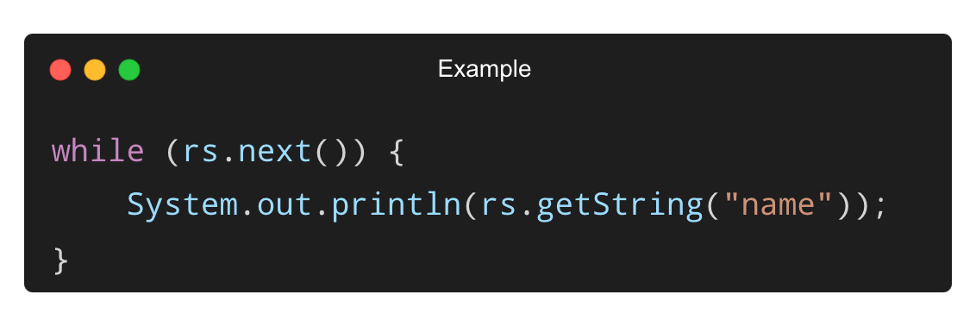
What is a ResultSet?
ResultSet holds the result of a query (like a cursor).
Use next() to move row by row.
✅ Can use getInt(), getString(), getDate() for different data types.

Slide 23
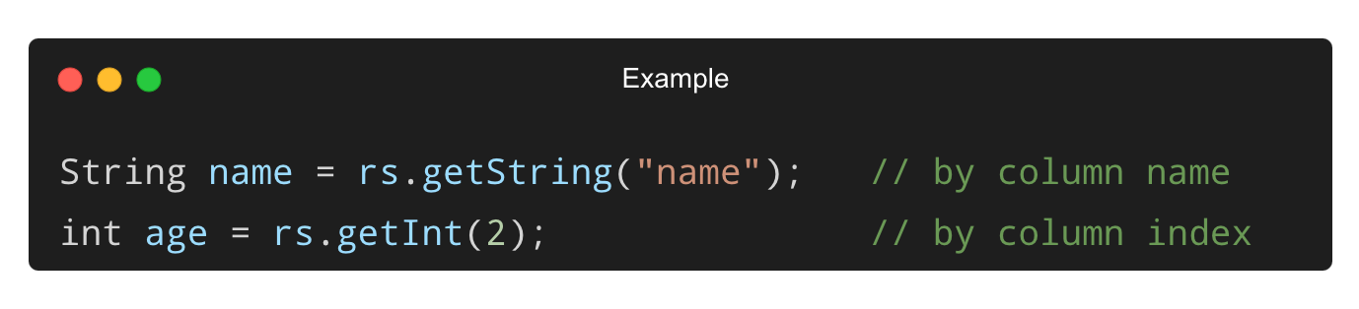
Column Access with ResultSet
✅ Column index starts from 1, not 0.
✅ Using names is safer and more readable.

Slide 24
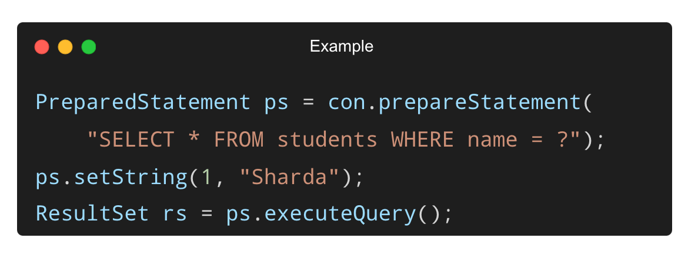
Using PreparedStatement (Better Practice)
✅ Prevents SQL injection
✅ Used for queries with dynamic parameters

Slide 25
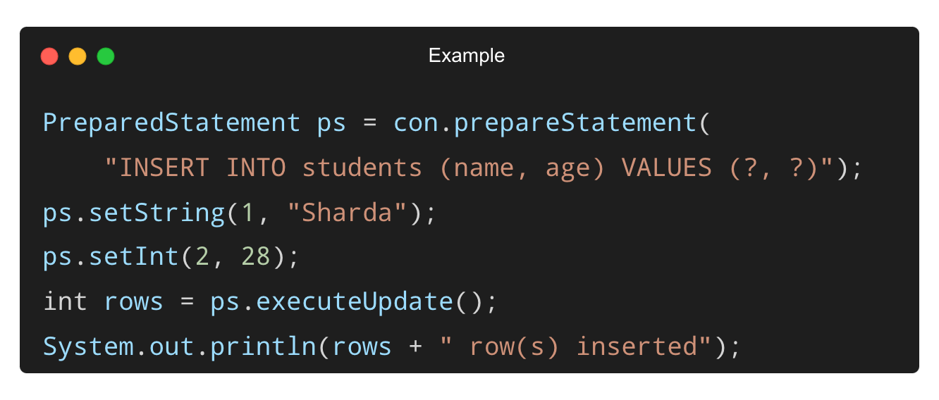
Inserting Data Using executeUpdate()
✅ executeUpdate() returns the number of affected rows.

Slide 26
Best Practices
✅ Always close Statement and ResultSet after use.
✅ Use PreparedStatement over Statement for dynamic values.
✅ Avoid SELECT * in production code.
✅ Catch and log SQL exceptions properly.

Slide 27
Metadata in JDBC

Slide 28
What is Metadata in JDBC?
Metadata refers to data about data.
JDBC provides metadata to help programs dynamically understand:
✅ Database properties
✅ Tables and columns
✅ Result set structure
✅ Helpful for building generic or reusable JDBC utilities.

Slide 29
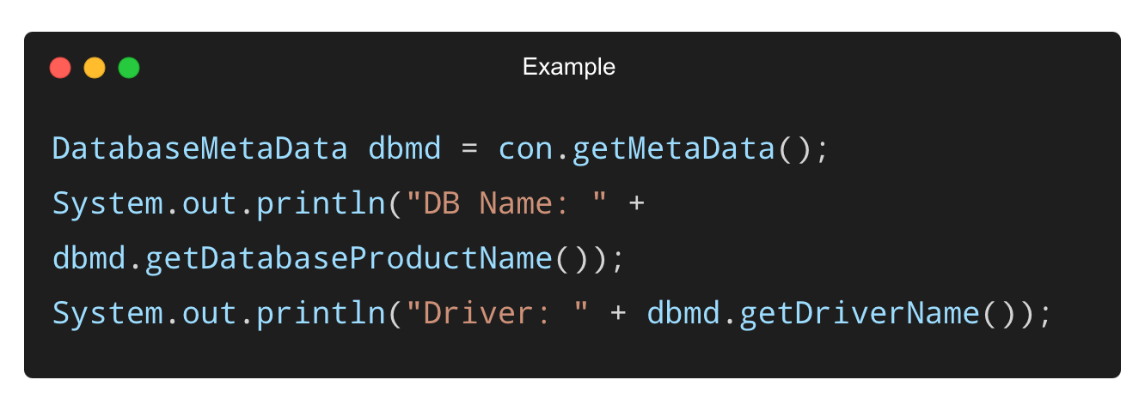
Using DatabaseMetaData
✅ Provides information about database version, driver, tables, etc.

Slide 30
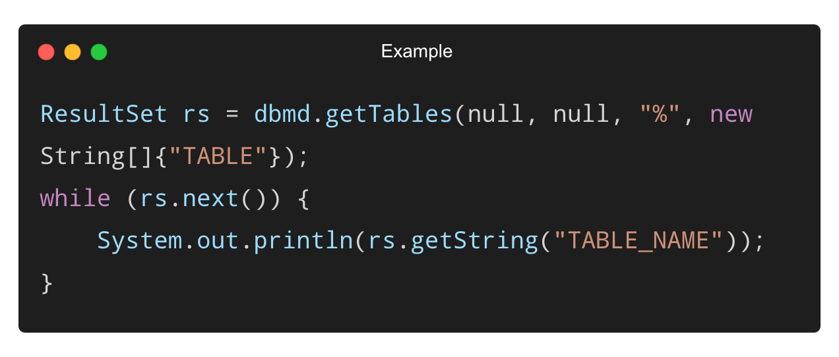
Listing All Tables in a Database
✅ Use getTables() to list all tables in the current database.

Slide 31
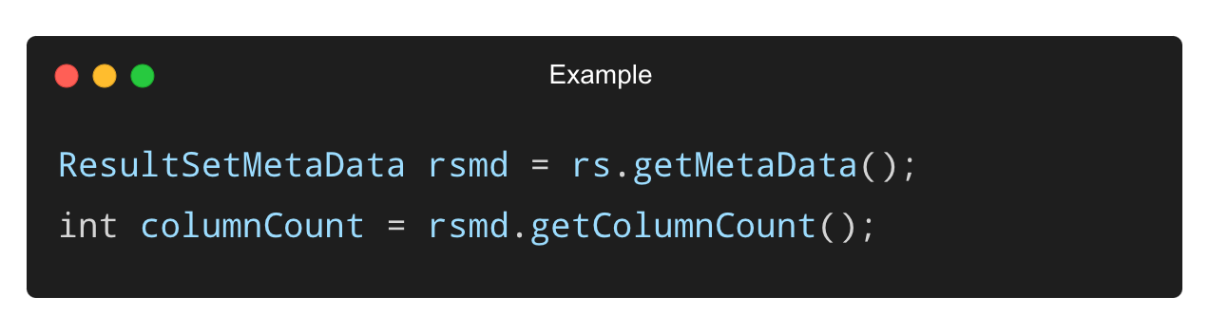
What is ResultSetMetaData?
Gives information about the columns in a result set.
Useful when structure is not known at compile time.
✅ Use it when building generic table display or dynamic reports

Slide 32
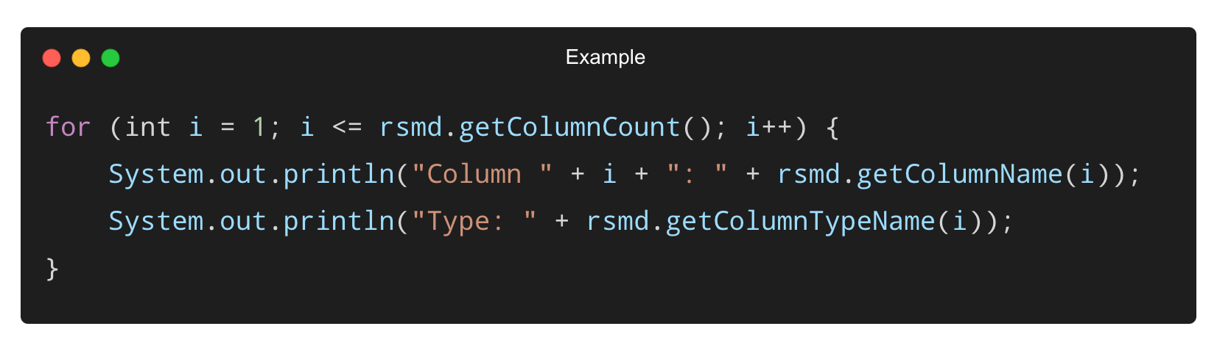
Accessing Column Info with ResultSetMetaData
✅ Helps you understand column names, types, sizes, etc.

Slide 33
Practical Use Cases of Metadata
✅ Auto-generating forms or tables
✅ Creating dynamic SQL queries
✅ Debugging database structure
✅ Data migration or sync tools
✅ Used in frameworks, libraries, and enterprise-level tools.

Slide 34
Best Practices with Metadata
✅ Use only when dynamic structure is needed.
✅ Close ResultSet after using metadata.
✅ Don’t rely on metadata in high-performance queries.
✅ Cache metadata info if repeatedly used.

Slide 35
Transaction Management in Java

Slide 36
What is a Transaction?
A transaction is a logical unit of work that must be completed entirely or not at all.
Follows the ACID properties:
✅ Atomicity
✅ Consistency
✅ Isolation
✅ Durability
✅ Used to prevent partial updates or inconsistent data.

Slide 37
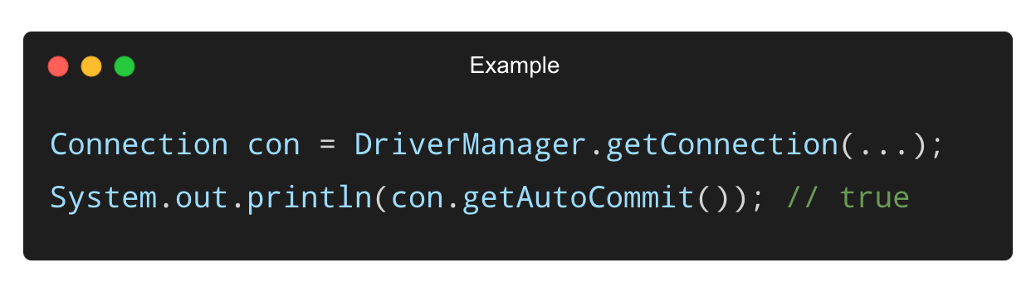
Default Behavior in JDBC
JDBC runs in auto-commit mode by default:
✅ Each SQL statement is committed automatically.
✅ Not suitable for multi-step operations.

Slide 38
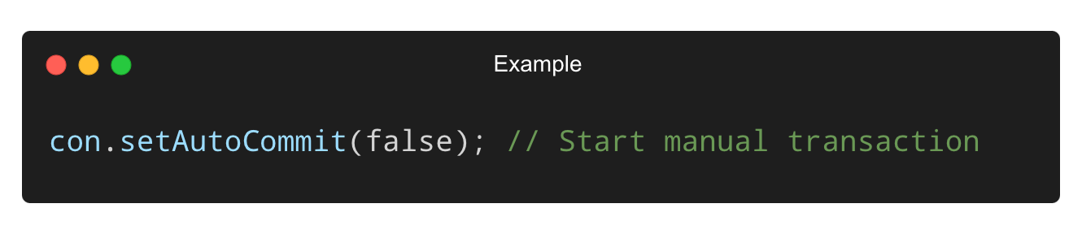
Disabling Auto-Commit
✅ Required to group multiple SQL statements into a single transaction.

Slide 39
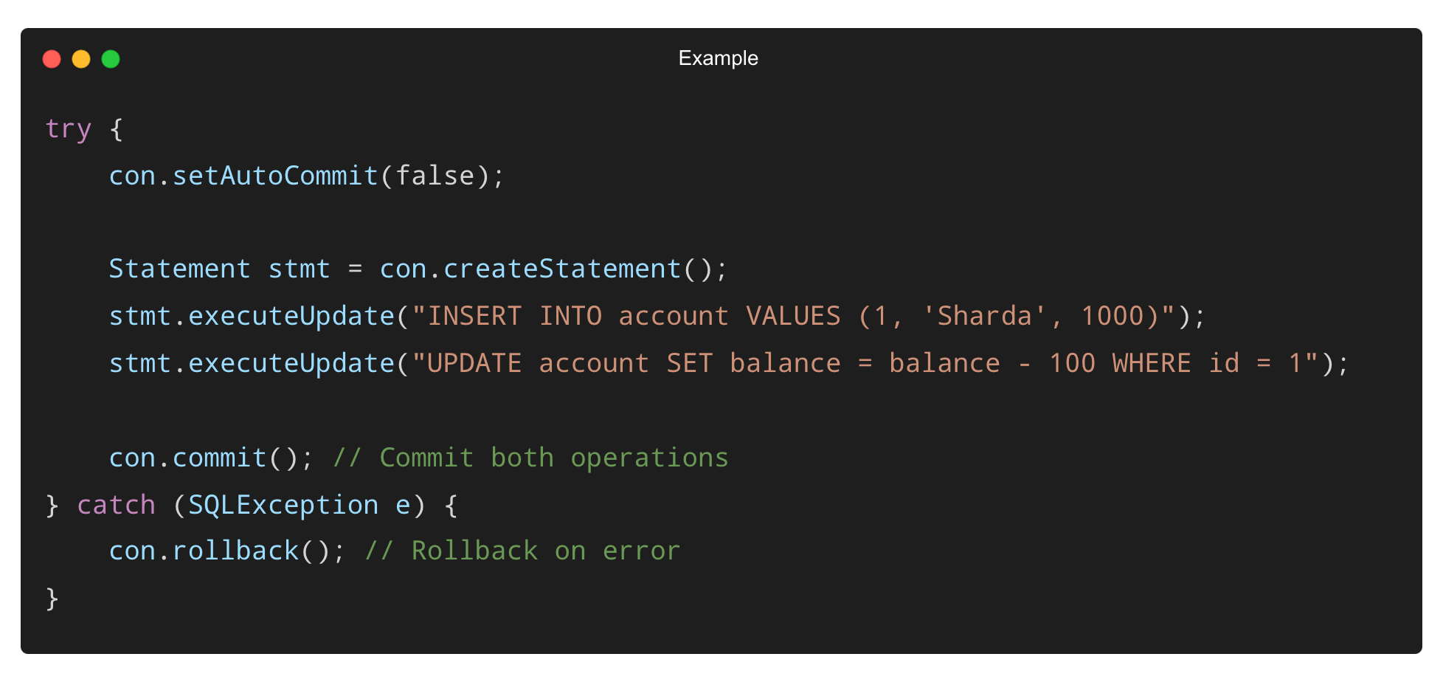
Performing Commit and Rollback
✅ Ensures both statements succeed or both fail.

Slide 40
When to Use Transactions
✅ Bank transfers
✅ Inventory updates
✅ Batch processing
✅ Multiple related changes to database
🚫 Avoid for simple, single-statement queries.

Slide 41
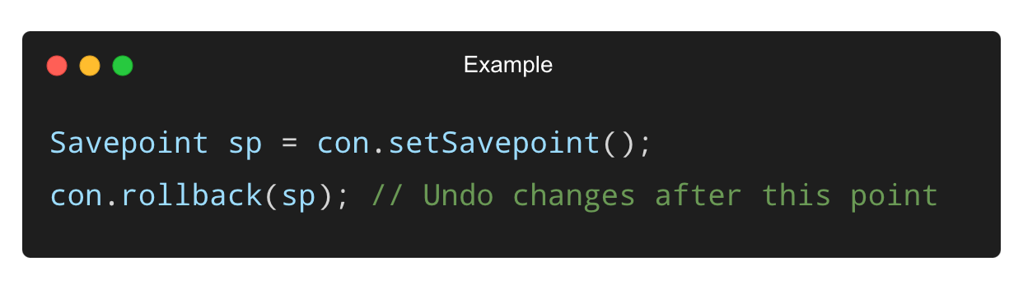
Savepoints in Transactions (Optional)
Used to rollback to a specific point within a transaction.
✅ Useful for partial rollback during complex workflows.

Slide 42
Best Practices for Transaction Management
✅ Always disable auto-commit only when needed.
✅ Use try-catch-finally or try-with-resources to ensure commit/rollback.
✅ Avoid long transactions — keep them short and fast.
✅ Handle rollback scenarios gracefully.

Slide 43
Data Types in JDBC

Slide 44
Overview of JDBC Type Mapping
JDBC translates SQL types into Java types via type mappings.
Mapped via java.sql.Types constants internally.
Handled automatically when using ResultSet or PreparedStatement.
✅ Ensures consistency across platforms and databases.

Slide 45
Common SQL–Java Type Mappings
SQL Type | Java Type | ResultSet Method | PreparedStatement Method
VARCHAR, CHAR | String | getString() | setString()
INT | int | getInt() | setInt()
BIGINT | long | getLong() | setLong()
DECIMAL, NUMERIC | BigDecimal | getBigDecimal() | setBigDecimal()
DATE | java.sql.Date | getDate() | setDate()
✅ Always use the correct method to match the SQL type.

Slide 46
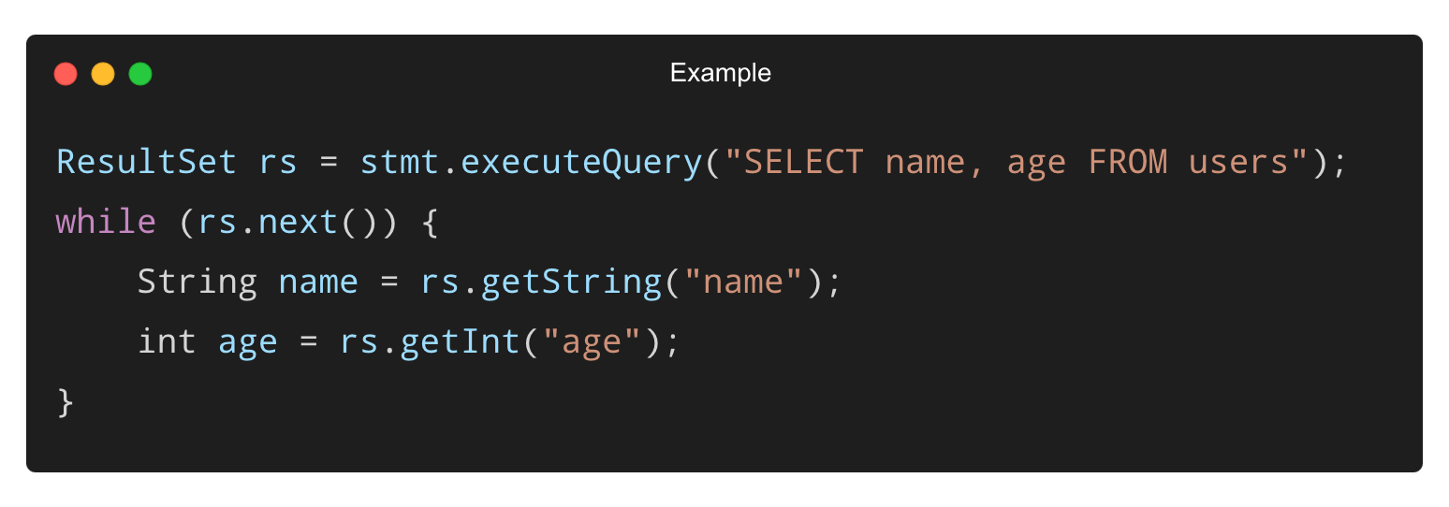
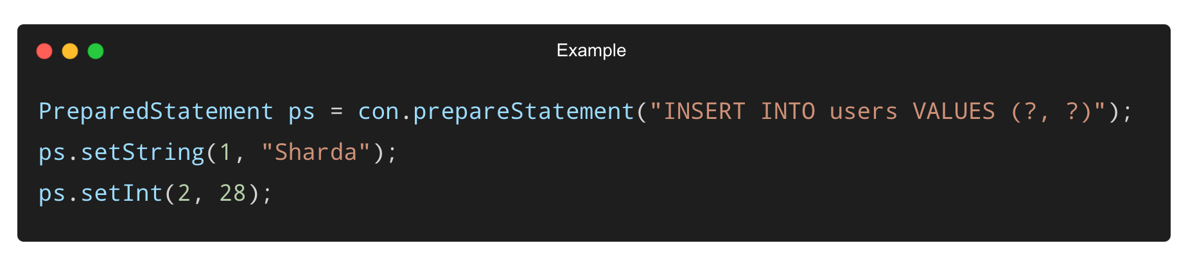
Example – Retrieving and Setting Values
✅ Use column name or index with appropriate type methods.

Slide 47
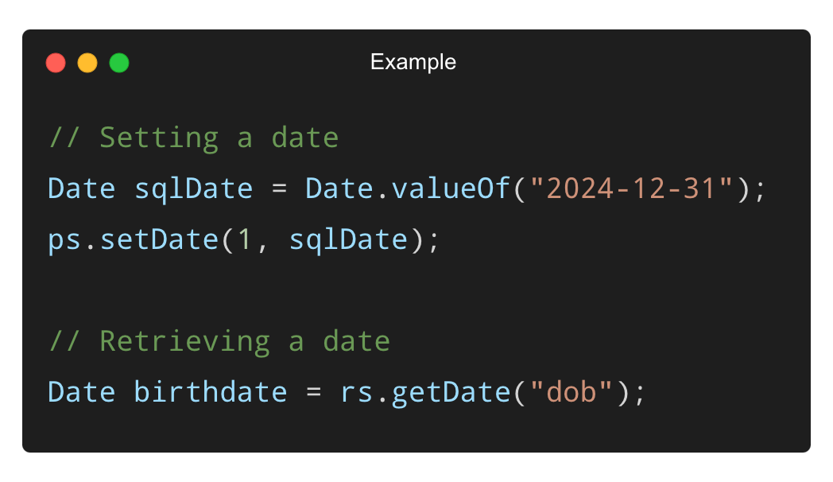
Working with Dates in JDBC
✅ Use java.sql.Date, Time, and Timestamp for date/time fields.
✅ Can convert to LocalDate using Java 8+ APIs if needed.

Slide 48
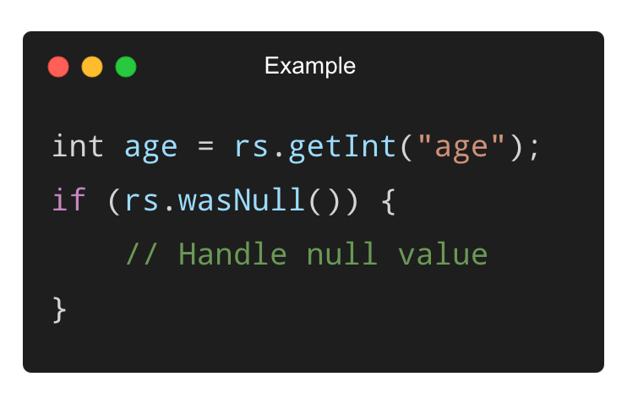
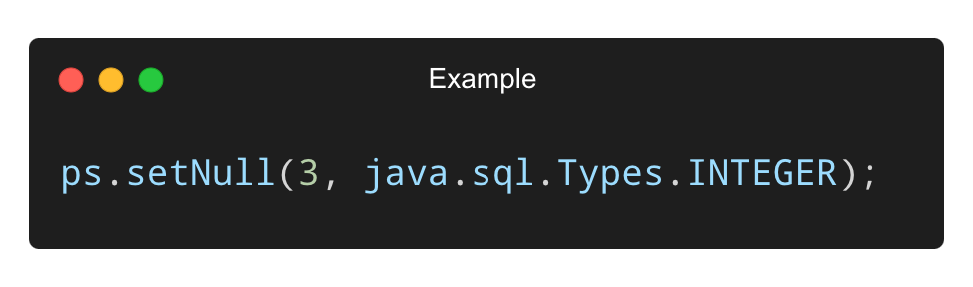
Handling Null Values
You can check if a value was null using:
To insert null:
✅ Important when working with optional fields or missing data.

Slide 49
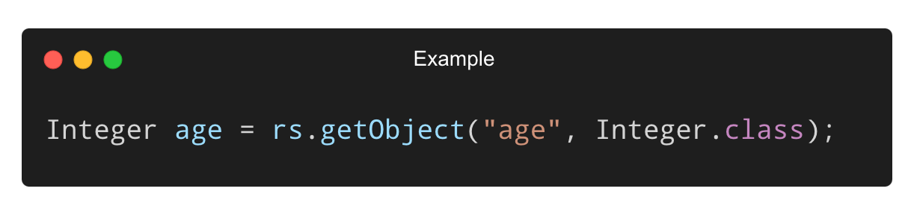
Using Wrapper Classes for Nullable Columns
✅ Prefer Integer, Double, Long over primitives (int, double, long) if values can be null.
✅ Helps avoid NullPointerException and improves null safety.

Slide 50
Best Practices for JDBC Type Handling
✅ Always match SQL column type with correct get/set method.
✅ Use parameterized queries to handle data securely.
✅ Handle nulls explicitly – don’t assume default values.
✅ Use ResultSetMetaData for dynamic type handling if needed.

Slide 51
Handling JDBC Exceptions

Slide 52
What is a SQLException?
SQLException is the base class for all JDBC exceptions.
Thrown when:
✅ Query is invalid
✅ Database is unreachable
✅ Driver fails to connect
✅ All JDBC operations that interact with the DB can throw this.

Slide 53
Common Causes of SQLException
Incorrect SQL syntax
Missing table or column
Wrong database URL or credentials
Constraint violations (e.g., duplicate key)
Network or driver issues
✅ These are typically runtime issues, not compile-time.

Slide 54
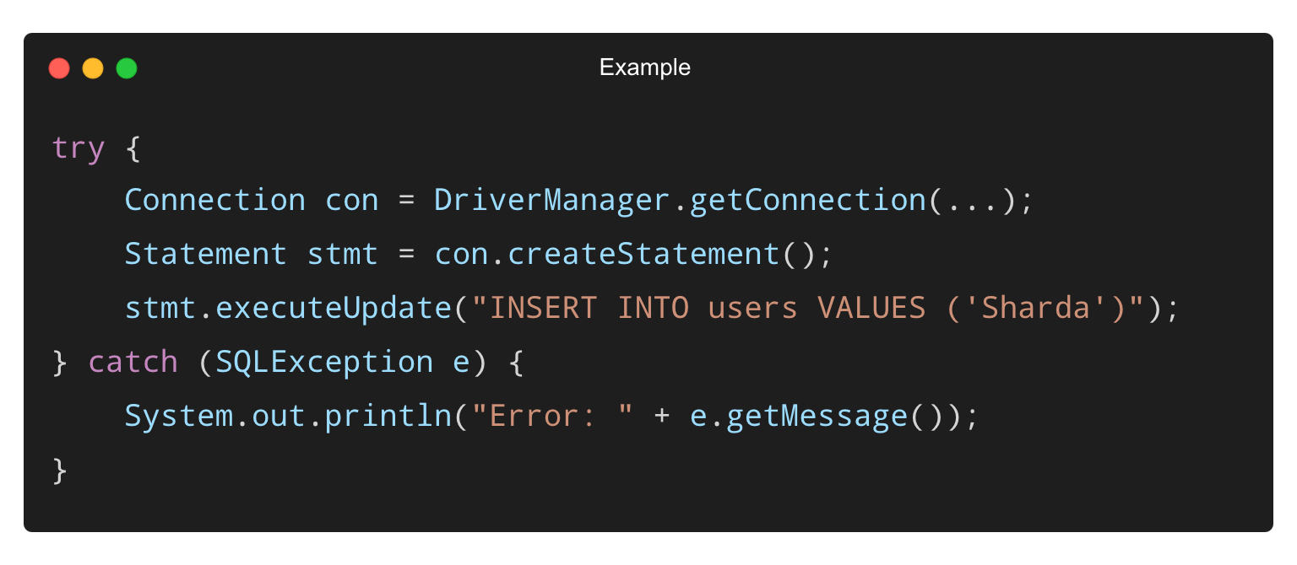
Basic Exception Handling Structure
✅ Enclose all DB code inside try-catch blocks.

Slide 55
Useful SQLException Methods
Method | Purpose
getMessage() | Gets error description
getErrorCode() | Vendor-specific code
getSQLState() | Standard SQL state string
getNextException() | Gets chained exceptions
✅ Use these to log and troubleshoot specific database issues.

Slide 56
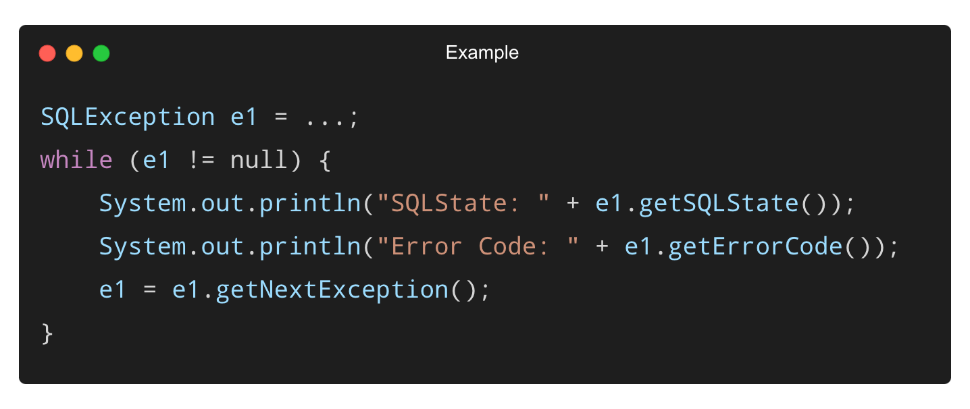
Handling Chained Exceptions
✅ Useful when multiple SQL errors occur together (e.g., batch updates).

Slide 57
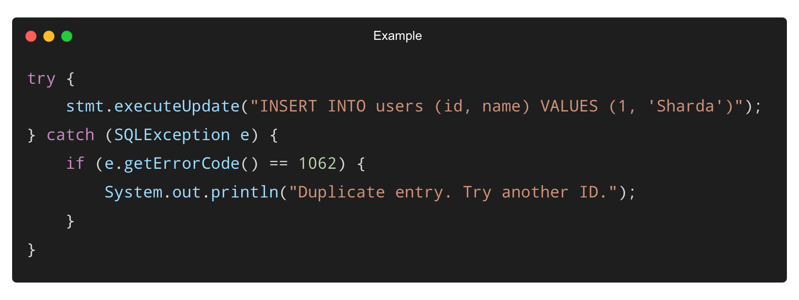
Example – Handling Duplicate Key
✅ Helps provide user-friendly error messages.

Slide 58
Best Practices for Exception Handling
✅ Always catch SQLException specifically.
✅ Log detailed messages with SQLState and ErrorCode.
✅ Avoid catching generic Exception unless necessary.
✅ Use finally block or try-with-resources to close connections.
✅ Never expose SQL error messages directly to users.

Slide 59
THANK YOU

